Slide 1
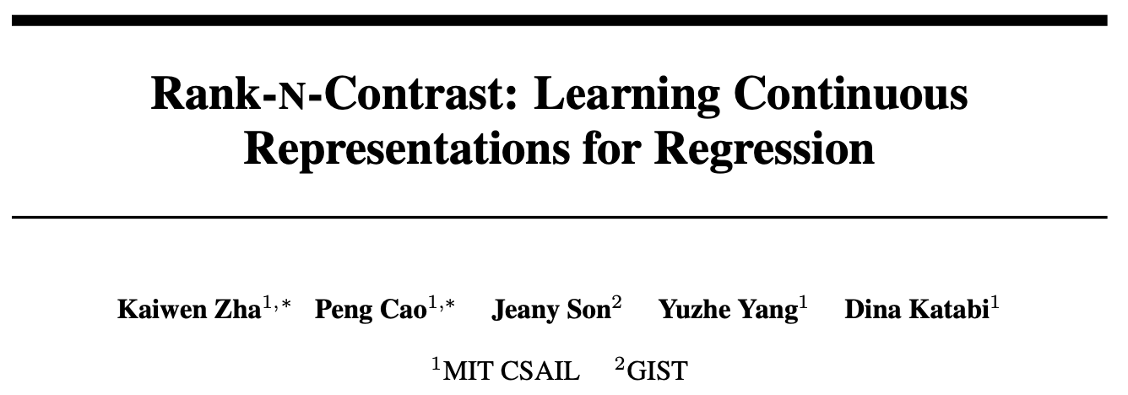
NeurIPS 2023 Spotlight
Group 3
Rishav Mukherji, Karan Bania, Tejas Agrawal, Arnav Goyal, Jinam Keniya

Slide 2
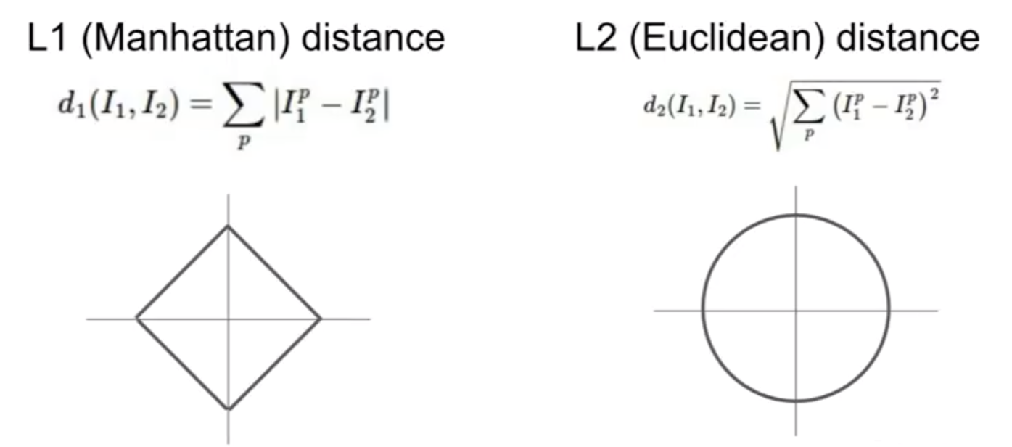
Introduction
Regression tasks are one of the most fundamental real world problems.
To carry out such tasks and make continuous value predictions, the widely utilised methods are distance-based loss functions such as L1 and L2 distance.
Earlier approaches concentrate on the final predictions in an end-to-end manner, without explicitly highlighting the representations acquired by the model.
Notes:
In statistical modeling, regression analysis is a set of statistical processes for estimating the relationships between a dependent variable and one or more independent variables

Slide 3
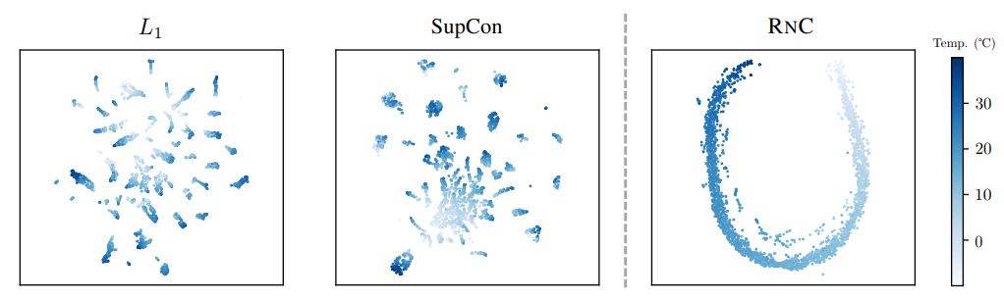
Introduction
Furthermore, there has been a lack of research regarding algorithms that capture the intrinsic continuity in data for regression
To fill this gap the authors introduce Rank-N-Contrast (RNC ), a novel framework for generic regression learning.

Slide 4
Contributions
They propose RNC, a simple and effective method designed to learn continuous representations for regression.
Extensive experiments are conducted on five diverse regression datasets across various domains such as vision, human-computer interaction, and healthcare. The results demonstrate the superior performance of RNC compared to state-of-the-art schemes.
Further analysis reveals properties of RNC regarding its data efficiency, robustness to spurious targets and data corruptions, and improved generalization to unseen targets.

Slide 5
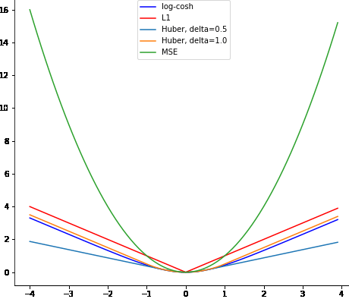

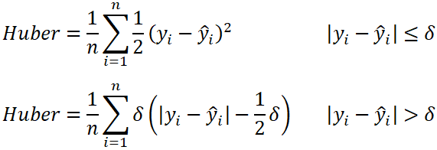
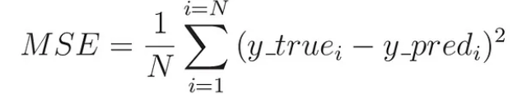
Related work
Current deep regression models lack "regression-aware" representations due to the end-to-end training focus on final predictions, not representation continuity
Several works casts regression as an ordinal classification problem using multiple binary classifiers based on ordered thresholds
Notes:
Current Standard regression losses include the L1 loss, the mean squared error (MSE) loss, and the combination of the 2, Huber loss, as Rishav pointed out, these, do no have continuity in their representation
To avoid the problem several works tried casting regression as an ordinal classification problem using multiple binary classifiers based on ordered thresholds but they either lack focus on continuous target space or are not universally applicable.

Slide 6
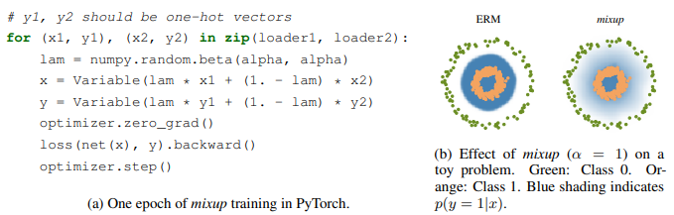
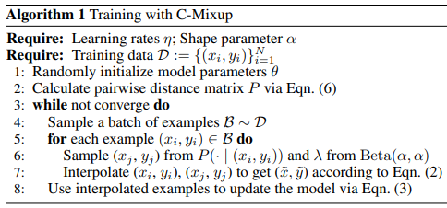
Related work
C-Mixup adapts the original mixup by adjusting the sampling probability of the mixed pairs according to the target similarities
C-Mixup, NeurIPS 2022
Original mixup, ICLR 2018
Notes:
RnC paper has 2 main concepts: Ranking and Contrasting. The idea of Ranking in RnC is inspired from C-mixup. Mixup is a simple learning principle to trains a neural network on convex combinations of pairs of examples and their labels. C-Mixup adapts the original mixup by adjusting the sampling probability of the mixed pairs according to the target similarities similar to how RnC ranks the contrastive pairs, which we obtain from supcon paper

Slide 7
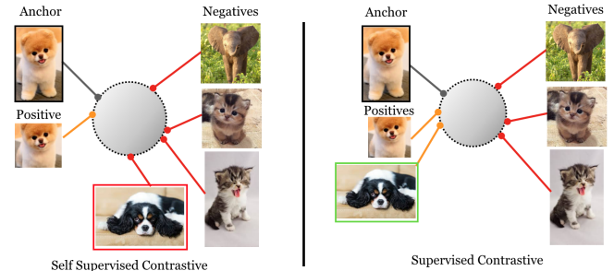
Related work
Contrastive learning excels in representation learning for classification
The supervised version of contrastive learning, SupCon, has been shown to outperform the conventional cross-entropy loss
Recent works adapt SupCon to tackle ordered labels in specific downstream applications
SupCon, NeurIPS 2020
Notes:
The Supervised Contrastive paper contrasts the set of all samples from the same class as positives against the negatives from the remainder of the batch to train an embedding space where elements of the same class are more closely aligned than in the self-supervised case.

Slide 8




Approach
Train a neural network consisting:
a feature encoder -
a predictor -
Augmentations are applied
This creates the augmented batch
(t and t’ are 2 separate augmentations)
Notes:
Neural network is trained, consisting of a feature encoder, which creates an feature embedding of dimension de. Which is then given to the predictor to give the final prediction output.
t and t’ 2 separate augmentations are applied, which in turn create the augmented batch {(xl, yl)} of size 2N.

Slide 9
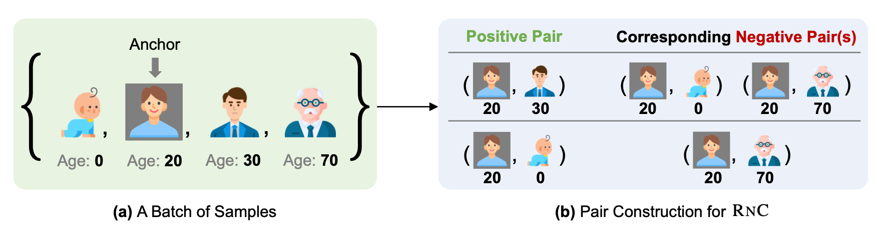
Approach
3. Create – and + pairs!
They choose an anchor vi and introduce a set Si,j which denotes the set of samples which are higher rank than vj in terms of label distance wrt vi.
d( , ) is the distance measure (eg. L1)
Notes:
The samples are then ranked according to the target distances and then contrast them against each other against each other based on the relative ranking.
Thus +ve and -ve pairs are created.
A anchor vector is chosen vi - in the example shown it is the person with age 20.
A set Si,j is created which consists of all vectors vk which have a label distance with vi, more than the distance between vi and another vector vj. - explain in example.

Slide 10
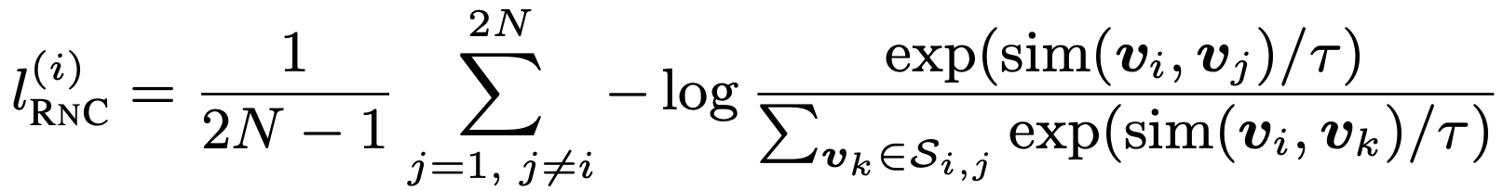
Approach
4. Loss function, basically, given an anchor, contrast each example with it’s negatives to impose an ordering.
5. L(rnc) is then enumerating over all 2N samples as anchors to enforce the entire feature embeddings ordered according to their orders in the label space:
Notes:
The denominator of the loss function is the sum of all vectors vk in the set Si,j.
Intuitively, for an anchor sample i, any other sample j in the batch is contrasted with it, thus the feature similarity between i and j will be larger than that of i and any other sample k in the batch. Minimizing the loss will help rank the feature embeddings in the label space w.r.t. anchor i.

Slide 11
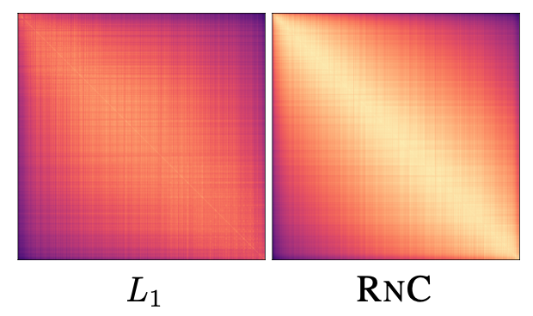
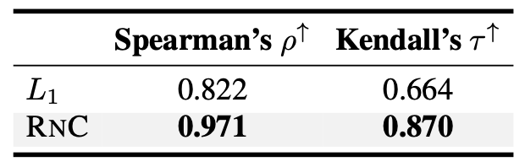
Approach
6. Feature Ordinality (data points sorted by ground truth) & Correlation.
Two qualitative metrics - Spearman’s rho and Kendall’s tau, both measures the strength of association between two ranked variables.
Notes:
The Similarity matrix is plotted, which clearly shows that the one with RnC has more stark contrast.
They have also evaluated 2 other qualitative metrics - Spearman’s rho and Kendall’s tau, which both measure the strength of association between 2 ranked variables.

Slide 12
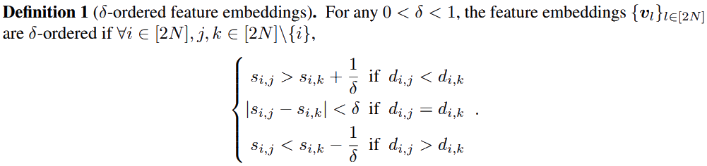
Theoretical Analysis –

Slide 13
Theoretical Analysis –
The paper proves these 3 theorems.

Slide 14
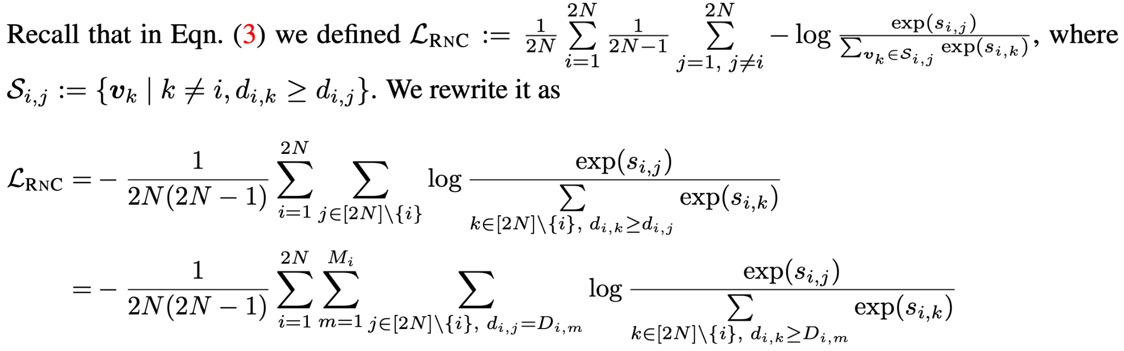
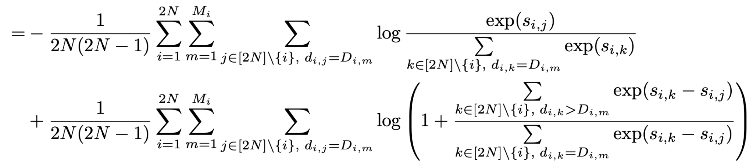
Theoretical Analysis –

Slide 15
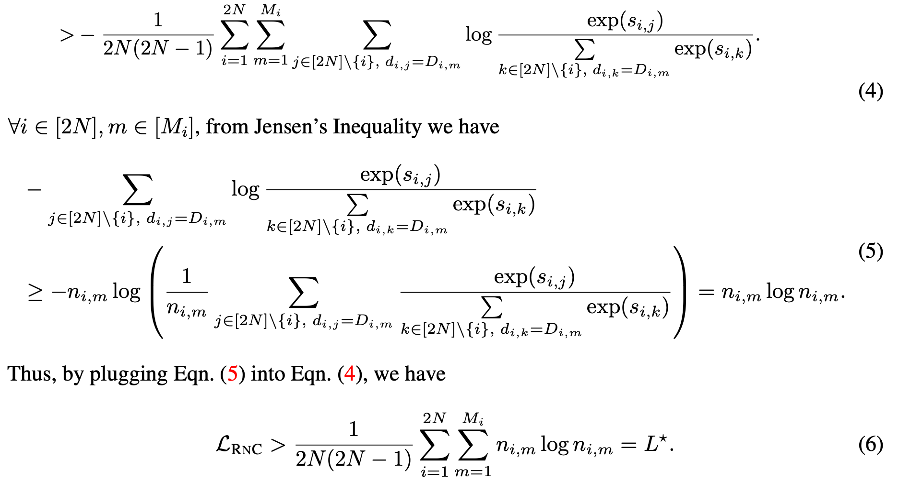
Theoretical Analysis –

Slide 16
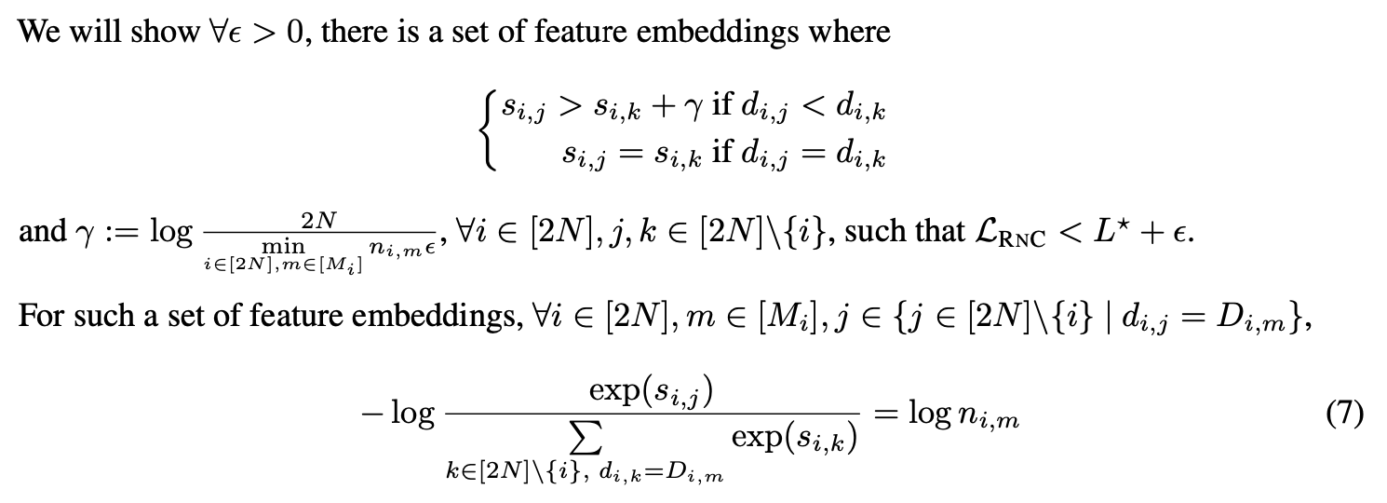
Theoretical Analysis –

Slide 17
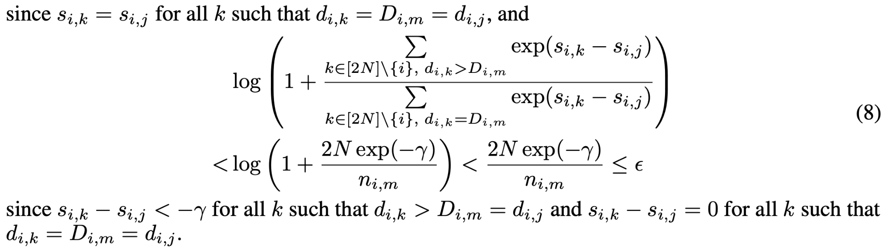
Theoretical Analysis –

Slide 18
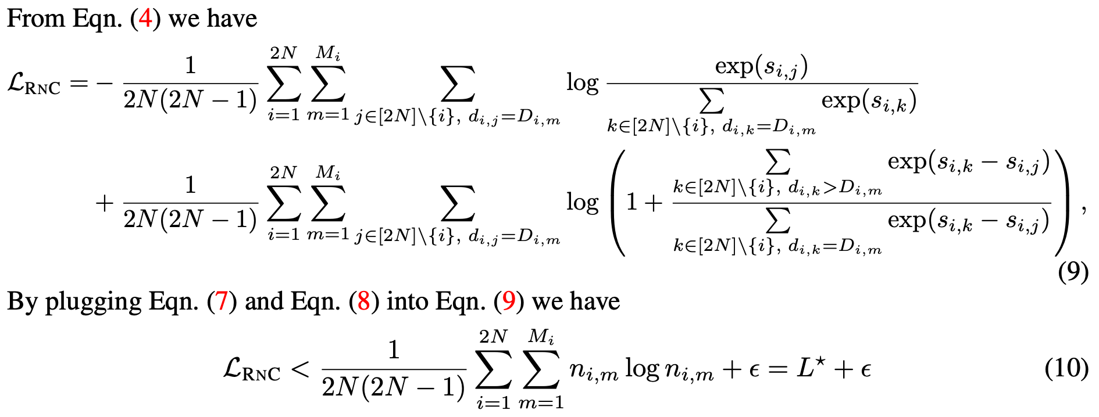
Theoretical Analysis –

Slide 19

Theoretical Analysis –
Connections of a δ-ordered embedding space to final performance and generalizability.
Monotonic function - a monotonic function (or monotone function) is a function between ordered sets that preserves or reverses the given order.
Rademacher Complexity - In computational learning theory (machine learning and theory of computation), Rademacher complexity, measures richness of a class of sets with respect to a probability distribution.

Slide 20
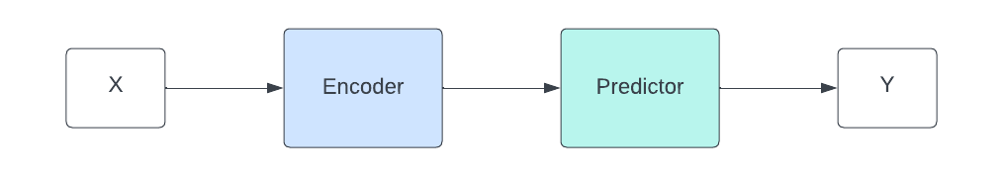
Methodology
Datasets Used
AgeDB
TUAB
SkyFinder
MPIIFaceGaze
Encoder is trained on the proposed LRNC to obtain feature embedding
Predictor is then trained on L1 loss
MAE is used as the metric for evaluation except for MPIIFaceGaze which uses Angular Error.

Slide 21
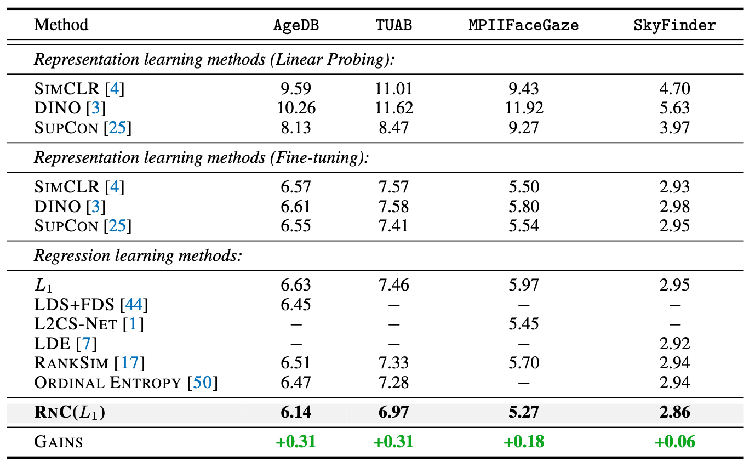
Experiments Results
Comparison to State of the Art.

Slide 22
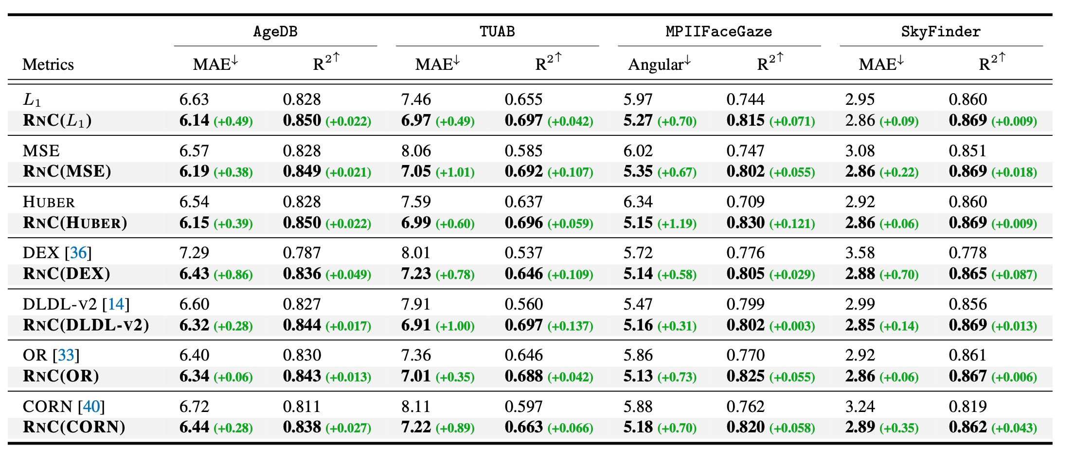
Experiments Results

Slide 23
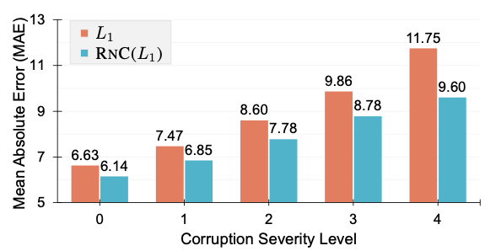
Robustness to Data Corruptions
Generated corruptions on AgeDB test set using ImageNet-C benchmark at various severity levels.
RNC consistently more robust and shows less performance degradation.

Slide 24
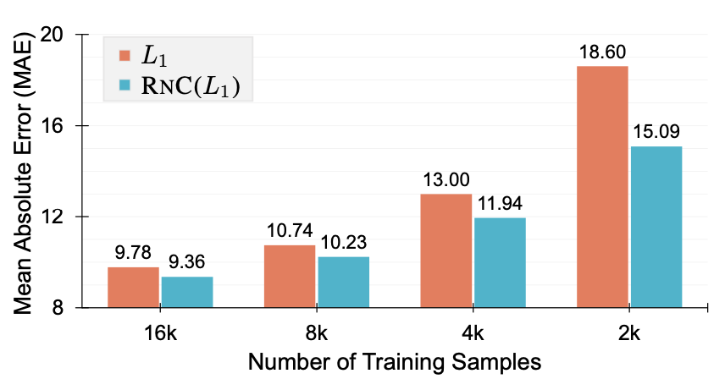
Resilience To Reduced Training Data
Subsampled IMDB-WIKI to generate training sets of various sizes.
RNC displays less performance degradation with decreasing training samples.

Slide 25
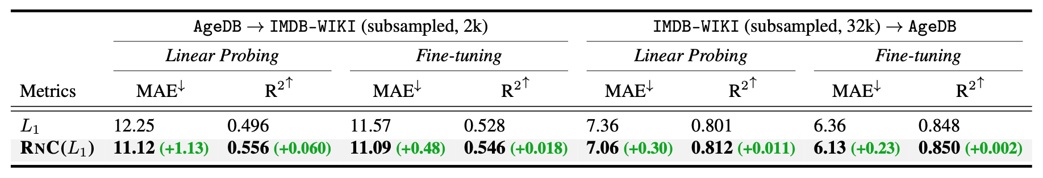
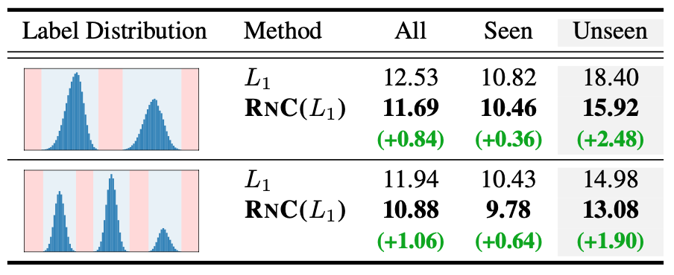
Experiments –
Transfer Learning.
Zero-shot generalization.

Slide 26
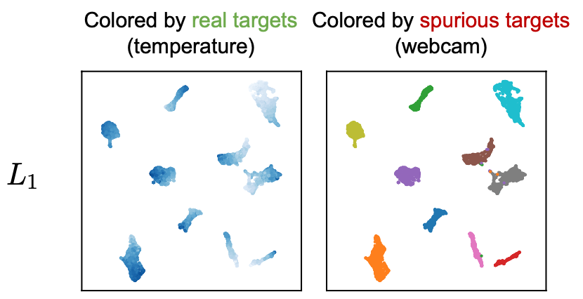
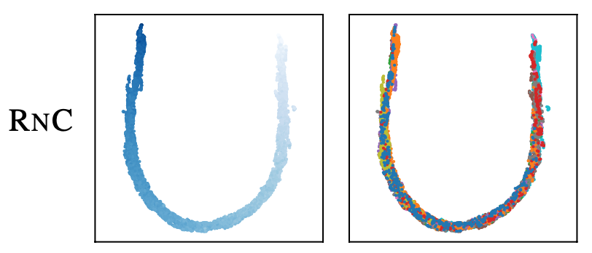
Ablation study –
Robustness to spurious targets.

Slide 27
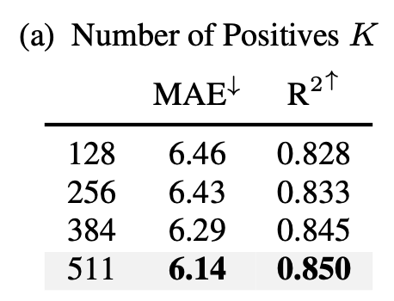
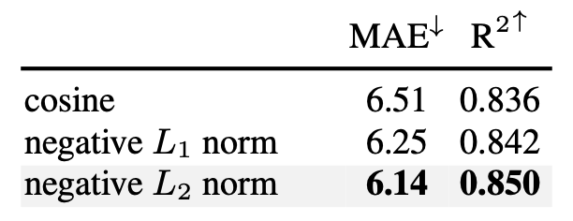
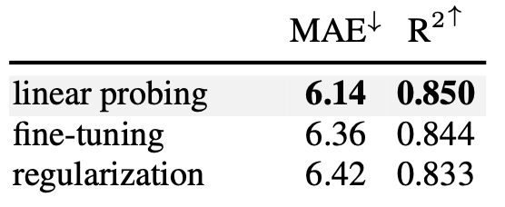
Ablation Study –
Number of positives.
Sim(., .) function effect.
Effect of training scheme.

Slide 28
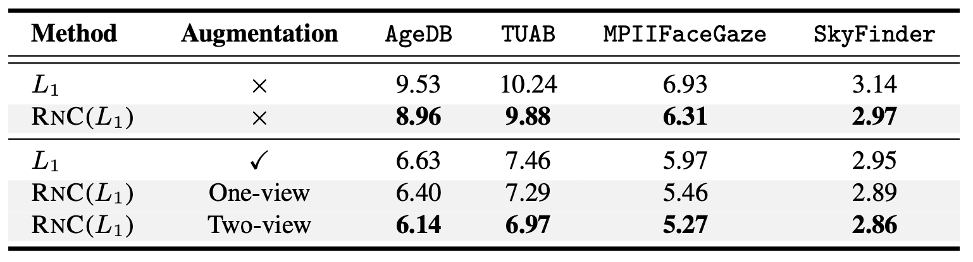
Further Experiments & Discussions –
Is augmentation necessary?

Slide 29
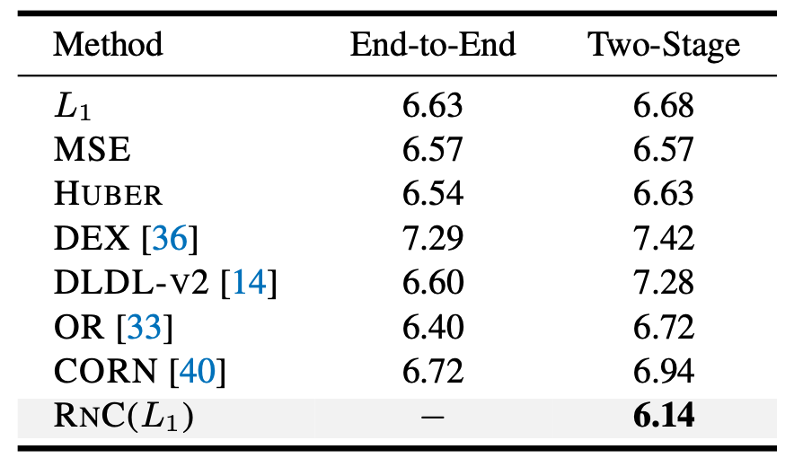
Ablation study -
Is RnC actually good or is it the 2-stage training?

